Slide 1

ET60012 FOUNDATIONS OF EDUCATIONAL TECHNOLOGY
Dr. Kaushal Kumar Bhagat
Centre for Educational Technology
Indian Institute of Technology Kharagpur

Slide 2
Gamification

Slide 3
Games Keeps Children Engaged for Hours
Design Right - Elements of Interest for a Good Game
Experience Design - Exploration, Hunting, Adventure, etc

Slide 4
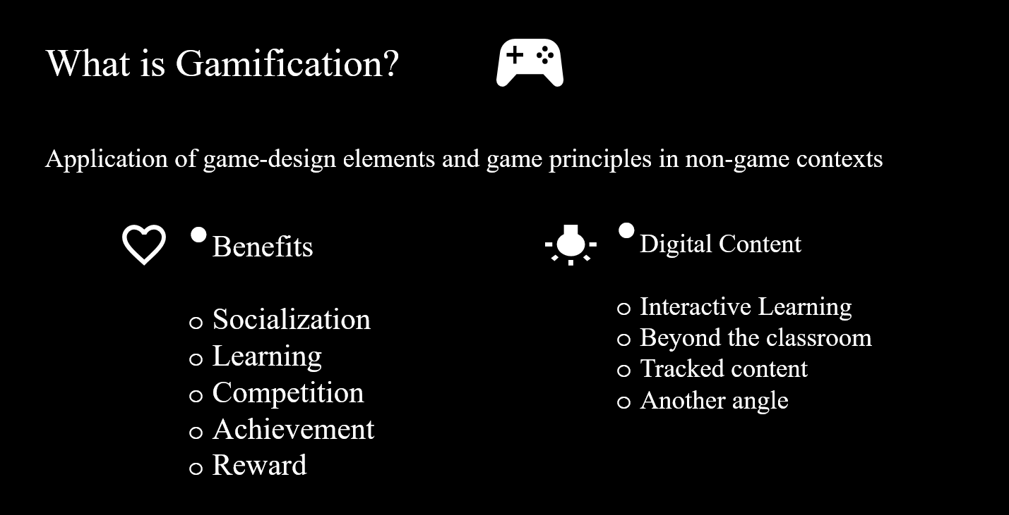

Slide 5
Mechanics
Fast Feedback : Immediate feedback or response to actions
Transparency : Where everyone stands
Goals : Short term and long term
Encourage users to continue or adjust their activities with onscreen notifications, text messages or emails.
Show users exactly where they stand on the metrics that matter to you and to your audience.
Missions or challenges give users a purpose for interaction, and educate users about what is valued and possible within the experience.

Slide 6
Mechanics
Badges : Evidence of accomplishments
Leveling up : Status within the community
Onboarding : An Engaging and compelling way to learn
An indicator of accomplishment or mastery of a skill is especially meaningful within a community that understands its value. Often used to identify skills and expertise within a group.
Levels indicate long-term or sustained achievement. Used to identify status within a community and to unlock new missions, badges, activities, and rewards.
Video games train you how to play as you play – users learn by doing. Simple missions help new users become engaged immediately as they master basic tasks, rather than being stumped by an unfamiliar interface or a detailed manual.

Slide 7
Mechanics
Points: Tangible, measurable evidence of my accomplishments
Used to keep score and establish status or accumulated to purchase virtual or real goods. Earn points through activities, sharing, contributing, or by creating something useful to others.
Competition: How I’m doing compared to others
Raise the stakes for accomplishing a goal by showing users how they compare to others, as individuals or in teams. Encourage competition with time-based, team and individualized leaderboards. Where do I rank? How can I overtake my closest competitor?
Community: A context for achievement
Collaboration: Accomplish a goal working with others
Community gives meaning to goals, badges, competitions, and other mechanics. Sharing participant achievements creates energy in the community by making people aware of what others are doing. They learn about goals, badges, and rewards that they may want to pursue.
Connect users as a team to accomplish larger tasks, to drive competition, and to encourage knowledge sharing. Show team members how they are contributing to the group’s success. No one wants to let down their team members.

Slide 8
